Slide 1
CUSTOMER LIFETIME VALUE
January 2017
PLATFORM ANALYTICS

Slide 2
AGENDA
Background
Methodology
Data preparation and Scoring
Model Results - Old Navy
Model Results - Gap
Model Results - Banana Republic
Next steps - Incorporate marketing costs
Use Cases & Success Measurements
Limitations
Economic value of customer experience
Appendix

Slide 3
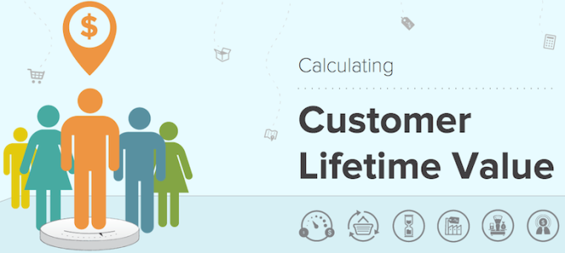
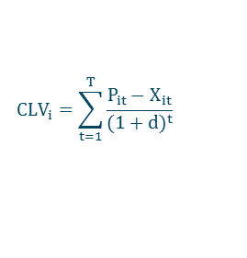

Definition of Customer Lifetime Value
The basic formula for calculating CLV for customer i and a finite time horizon(T):
$P_{it}$: Net revenue generated from the customer’s relationship at time t
$${CLV}_{i}=\sum_{t=1}^{T}{\frac{P_{it}−X_{it}}{{(1+d)}^{t}}}$$
$X_{it} :$Cost incurred from the service/product/marketing campaign at time t
$d$: Discount Rate
Cost Type | Details | History | Source | Comments
Marketing Costs | Cost of DM sends | 12 months | MDS on 1.x | Limited History
 | Cost of EM sends | 3 months | MDS on 1.x | Limited History
 | Cost of DGM | 3 months | Convertro on 1.x | Limited History
Shipping Costs for Online Orders | Shipment Cost | 24 months or more | Venus on 1.x | 60% Match
 | Return Shipment Cost | 24 months or more | Venus on 1.x | Can’t tie back
Cost of Products |  | 24 months or more | MDS on 1.x | Available
Transactions |  | 24 months or more | MDS on 1.x | Available
Customer Service | Cost of call center | - | - | Not Available
Possible Modelling Approaches :
Pareto - NBD
BG - NBD
Simultaneous Equation Models
Markov Chains
Photo Source: http://www.preapps.com/blog/lifetime-value-get-longterm-success

Slide 4

BACKGROUND
Objective:
To enhance existing Customer Lifetime Value (CLTV) models to predict expected margin in addition to expected spend so that we can identify and target the most revenue generating as well as profitable customers
Definition:
CLTV is defined as a prediction of the net worth attributed to the entire future relationship with a customer.
Existing Version:
Customer’s forecasted spend at time T =
forecasted average spend * expected no. of transactions at time T
Proposed Version:
Customer’s forecasted margin at time T =
forecasted average margin * expected no. of transactions at time T
T can take any value, e.g. 12 months / 52 weeks, 18 months / 78 weeks, ...
Photo Source: https://pixelter.com/blog/customer-lifetime-value/

Slide 5
STATISTICAL METHODOLOGY
Pareto-NBD is composed of three independent components:
Pareto – Dropout Process
Predicts a customer’s lifetime that is the probability of ‘being alive’ with the brand
Customer’s lifetime is Exponentially distributed with parameter µ_{i}
µ_{i} is Gamma distributed with parameters r and α
Negative Binomial (NBD) – Purchase Process
Predicts the number of transactions made by a customer while still alive with the brand
While alive, the number of transactions made by a customer follows a Poisson process that is Exponentially distributed with parameter λ_{i}
λ_{i} is Gamma distributed with parameters s and β
Gamma Gamma – Monetary Value
This component predicts the customer’s average spend per transaction
the customer’s average spend per transaction is Gamma distributed with parameter υ
υ is Gamma distributed with parameter υx
Model Inputs for Expected Spend Model
Recency, Frequency, Average Spend, Tenure
Average Spend = Gross Demand – Discounts
Model Inputs for Expected Margin Model
Recency, Frequency, Average Margin, Tenure
Average Margin = Gross Demand – Discounts – Product Cost
Present
Future
Is a customer still going to be shopping with us in the future?
Literature source: http://www.brucehardie.com/papers/rfm_clv_2005-02-16.pdf

Slide 6
MODELING FRAMEWORK
Algorithm: Pareto-NBD Models
Data: Transaction & CRM Data
Sources: MDS Big-D Cluster 1.x
Platforms: Hadoop/Hive, R
Total customers: 26.5 M
Training
Validation
Jan 2015 – Dec 2015 (12months)
Jan 2016 – Dec 2016 (12months)
Data preparation and cleaning in Big Data
Calculate summary statistics at customer level
Standardize variables and cap outliers
Model Evaluation and Validation
Compute forecasted CLTV
Model Training in R

Slide 7
OLD NAVY - PARETO NBD MODEL
Expected Spend 12mo
Expected Spend 12mo
Expected Margin 12mo
Actual Spend 12mo
Actual Spend 12mo
Actual Margin 12mo
Percentiles
Percentiles
Percentiles
Figure 1 shows Actual Spend vs Expected Spend between Jan 2016 to Dec 2016 scored by Pareto-NBD and Gamma-Gamma models which are already in production.
Figure 2 shows Actual Spend vs Expected Spend between Jan 2016 to Dec 2016 scored by re-estimated Pareto-NBD and Gamma-Gamma models using transaction data from Jan 2015 to Dec 2015
Figure 3 shows Actual Margin vs Expected Margin between Jan 2016 to Dec 2016 scored by Pareto-NBD and Gamma-Gamma models using transaction data from Jan 2015 to Dec 2015.

Slide 8
GAP - PARETO NBD MODEL
Expected Spend 12mo
Expected Spend 12mo
Expected Margin 12mo
Actual Spend 12mo
Actual Spend 12mo
Actual Margin 12mo
Percentiles
Percentiles
Percentiles
Figure 1 shows Actual Spend vs Expected Spend between Jan 2016 to Dec 2016 scored by Pareto-NBD and Gamma-Gamma models which are already in production.
Figure 2 shows Actual Spend vs Expected Spend between Jan 2016 to Dec 2016 scored by re-estimated Pareto-NBD and Gamma-Gamma models using transaction data from Jan 2015 to Dec 2015
Figure 3 shows Actual Margin vs Expected Margin between Jan 2016 to Dec 2016 scored by Pareto-NBD and Gamma-Gamma models using transaction data from Jan 2015 to Dec 2015.

Slide 9
BANANA REPUBLIC - PARETO NBD MODEL
Expected Spend 12mo
Expected Spend 12mo
Expected Margin 12mo
Actual Spend 12mo
Actual Spend 12mo
Actual Margin 12mo
Percentiles
Percentiles
Percentiles
Figure 1 shows Actual Spend vs Expected Spend between Jan 2016 to Dec 2016 scored by Pareto-NBD and Gamma-Gamma models which are already in production.
Figure 2 shows Actual Spend vs Expected Spend between Jan 2016 to Dec 2016 scored by re-estimated Pareto-NBD and Gamma-Gamma models using transaction data from Jan 2015 to Dec 2015
Figure 3 shows Actual Margin vs Expected Margin between Jan 2016 to Dec 2016 scored by Pareto-NBD and Gamma-Gamma models using transaction data from Jan 2015 to Dec 2015.

Slide 10
ATHLETA - PARETO NBD MODEL
Expected Spend 12mo
Expected Spend 12mo
Expected Margin 12mo
Actual Spend 12mo
Actual Spend 12mo
Actual Margin12mo
Percentiles
Percentiles
Percentiles
Figure 1 shows Actual Spend vs Expected Spend between Jan 2016 to Dec 2016 scored by Pareto-NBD and Gamma-Gamma models which are already in production.
Figure 2 shows Actual Spend vs Expected Spend between Jan 2016 to Dec 2016 scored by re-estimated Pareto-NBD and Gamma-Gamma models using transaction data from Jan 2015 to Dec 2015
Figure 3 shows Actual Margin vs Expected Margin between Jan 2016 to Dec 2016 scored by Pareto-NBD and Gamma-Gamma models using transaction data from Jan 2015 to Dec 2015.

Slide 11
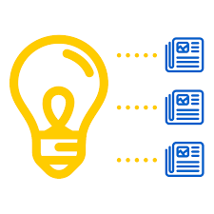

USE CASES & SUCCESS MEASUREMENT
Usage:
Number of Business Units Utilizing or Adopting the output
Profit/Margin Uplift in $, Response Uplift, Savings in $
Average Survey Scores defining the utility of Model Scores
Analytic Quality:
Training and Validation Accuracy & Other Metrics
Validation with Financial Forecasts and Actuals
Prioritizing Marketing Campaign Leads:
Baking LTV scores in lead generation(in conjunction with other Model Scores – like Acquisition, EM, DM etc.) will help in optimally picking up leads, so as to Maximize Revenue from a given Campaign
Foundation Model for Future Analysis & Segmentation:
Card Programs, Cross Sell and Upsell Engagement Program, Best Customer Segmentation, Optimal Contact Strategy
Generating Business Forecast & Asset Evaluation:
Aggregating Customer Forecasts and generating forecasts for brands/overall business(bottoms up approach) – Planning, Budgeting, Asset Evaluation

Slide 12
APPENDIX

Slide 13
TIMELINES AND MILESTONES - COMPLETED
Steps | Resources | Milestones | 11/28-12/04 | 12/05-12/11 | 12/12-12/18 | 12/19-12/25 | 12/26-01/01 | 01/02-01/08 | 01/09-01/15 | 01/16-01/22 | 01/23-01/29
Scoping | Sulabh, Tanumoy, Jewels | Scoping Doc
Calculating CLV | Sulabh, Shraddha | CLV Rollup & Validation
Predictor Data Prep | Sulabh, Shraddha | EDA Report
Modeling Iterations Field Testing | Tanumoy Jewels | Pareto NBD Models
 | Tanumoy Jewels | BG NBD Models
Completed
Underway

Slide 14
Further Enhancements
Economic Value of Experience
Feedback, reviews and recommendations from customers on site / social media/ surveys
Incremental Revenue from customers who have left a positive feedback
Incremental Revenue from customer’s social network contacts after leaving a positive feedback
Share of Wallet –
How much is a customer spending at our brands out of his entire expenditure on apparels?
Identify Advocacy / Acquisition opportunities

